Slide 1
Members Forum
Access and Review

Slide 2
Agenda
Review the Basics
Demo
Topics
Likes/Dislikes/Improvements
Training/Rollout
Success Factors

Slide 3
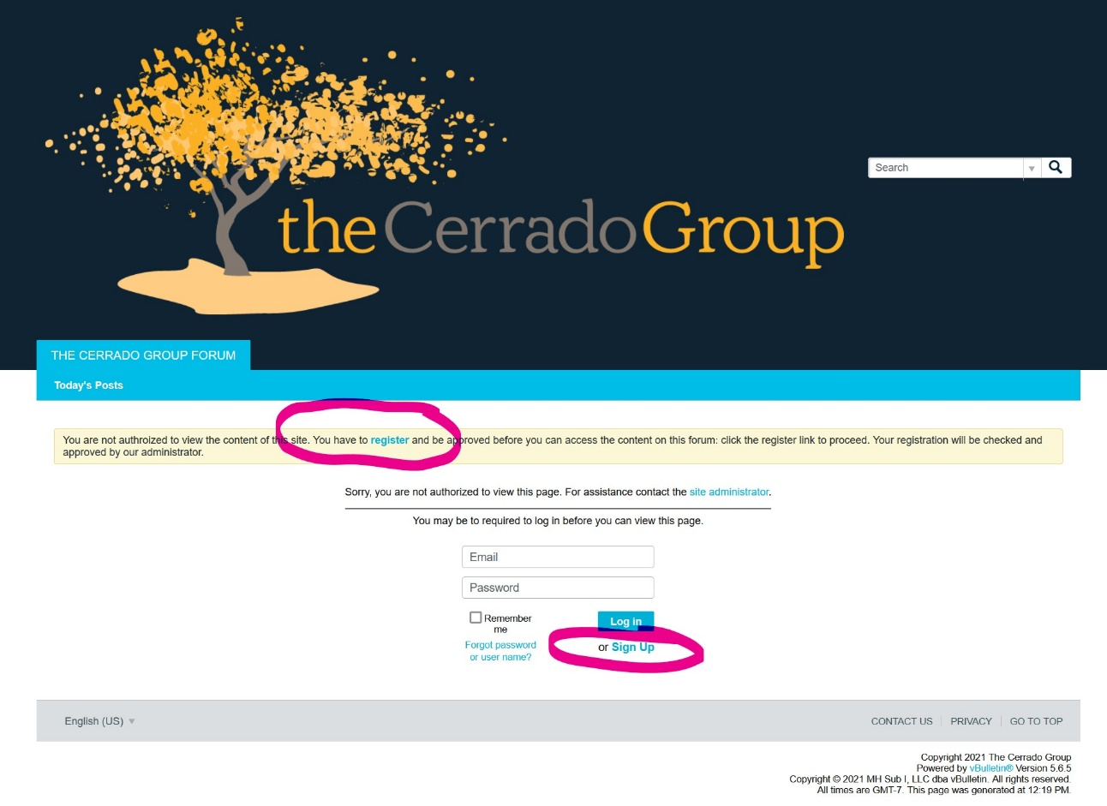
Review the Basics
Sign-up Procedure
These are the instructions for logging into the Cerrado Group Forum.
The process is pretty straightforward and should only take a couple of minutes,
and a couple of emails.
The address for the forum is:
https://478cc3fdea6d-005790.vbulletin.net/forum/main-forum
When you get to the forum page you will need to “sign-up” to register.
Please fill in the required information and submit it. Once you submit the registration, Sunray will be notified that you did. You will also get an email asking you to confirm your email address. Once you do this Peter will then be able to “approve” your membership to the site – you will also get an email notifying you of the approval. Once that happens you can log in to the site and begin using the forum.

Slide 4
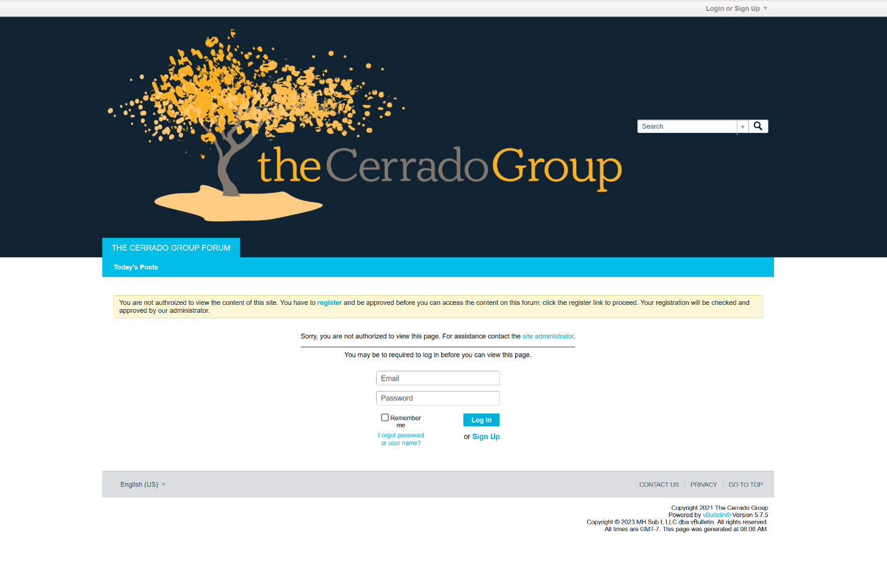
Review the Basics
Log-in Procedure
These are the instructions for logging into the Cerrado Group Forum.
The address for the forum is:
https://478cc3fdea6d-005790.vbulletin.net/forum/main-forum
When you get to this screen you will need to enter your Email and the password that you created when you registered for the site.
If you forget your password – Peter cannot tell you what it was – so please click the “Forgot Password” link and reset it. If you are still having an issue – reach out to Peter and he can manually reset, it for you. If you forgot your Login Name – Peter can tell you what you used to sign-up.
peter@sunraydirect.com.

Slide 5
Subscribe
The first thing you should do once you have logged in is to subscribe to each category
There is a SUBSCRIBE box next to each category that you check
If you don’t do this you will not be notified when there is a new post for the category
Should I ask Peter to get rid of this and assume you want to subscribe to all categories?

Slide 6
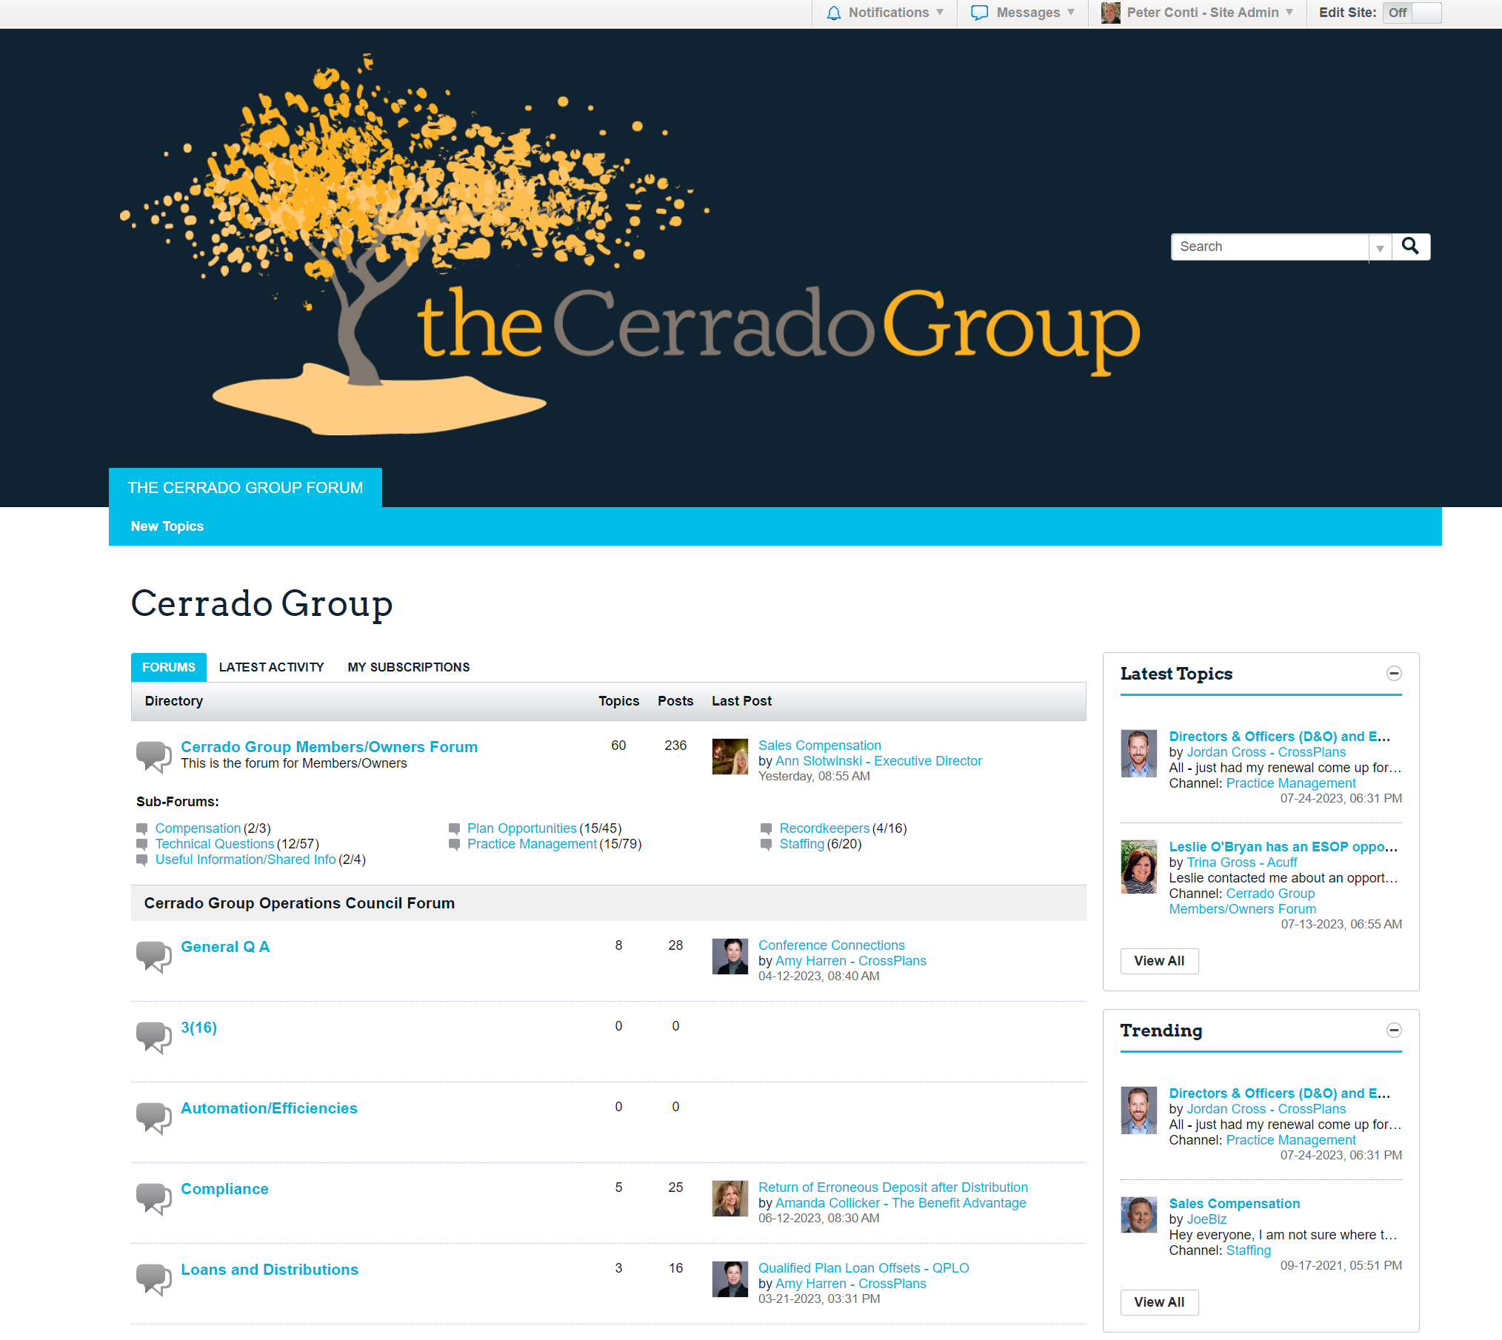
Review the Basics
Home Page
This is the landing page (a piece of it) once you sign into the forum.
From here you can see what the most recent topics are and what is trending with the group – this is on the RIGHT side. You can click on anything in BLUE to open it further.
As owner members you can also see what is in the Operations Council Group and the Sales Council Group areas.

Slide 7
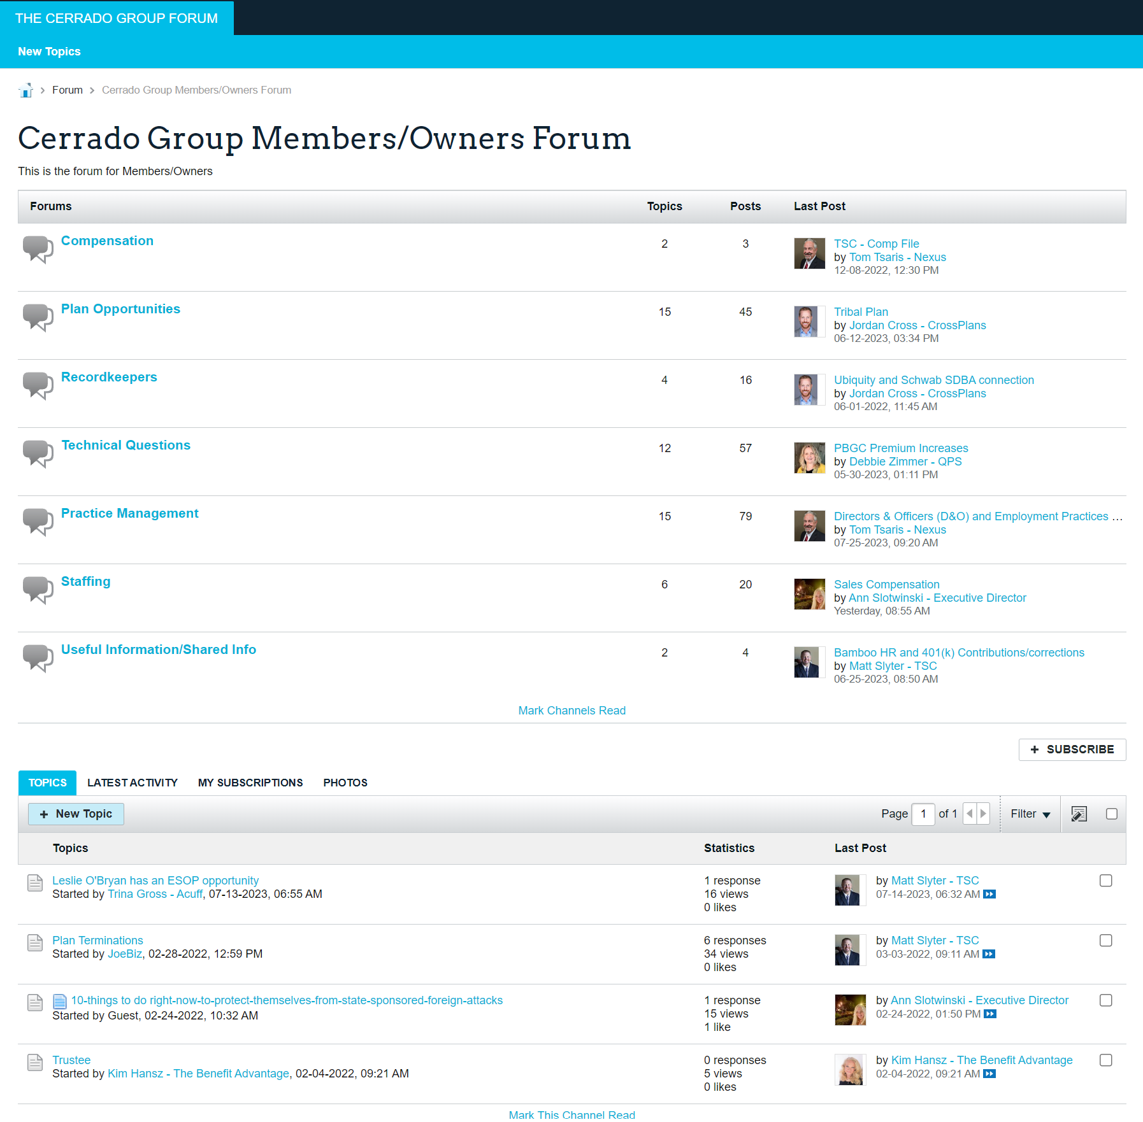
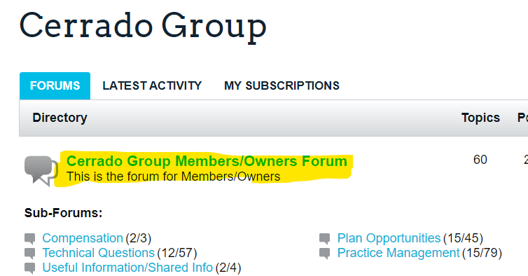
MEMBER OWNERS FORUM PAGE
If You select the highlighted item (in yellow below) from the HOME page, you are taken directly to the Member/Owners Page – where you can see the specific Topic Areas available.
You can also see on the right who made the last post in that area and how many posts there are as well.

Slide 8
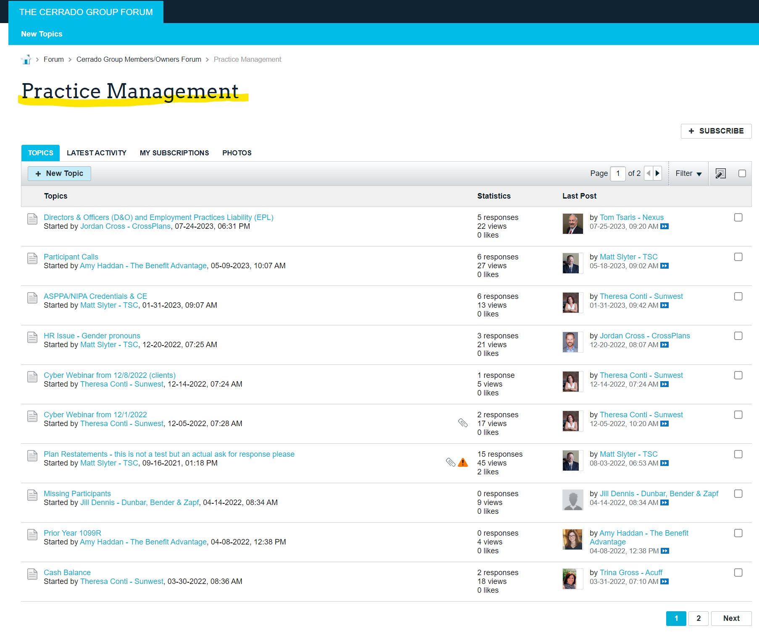
Review the Basics
MEMBER OWNERS FORUM – Topic Area Page
When you select a Topic Area from the Owners page (Practice Management in this case) you will see the list of topics on that page that are or have been added by another member.
Again, the right side of the page shows the last person to respond, the date of that response, the number or responses and views of that topic.
If you select any of the items in BLUE you are taken to that topic.

Slide 9
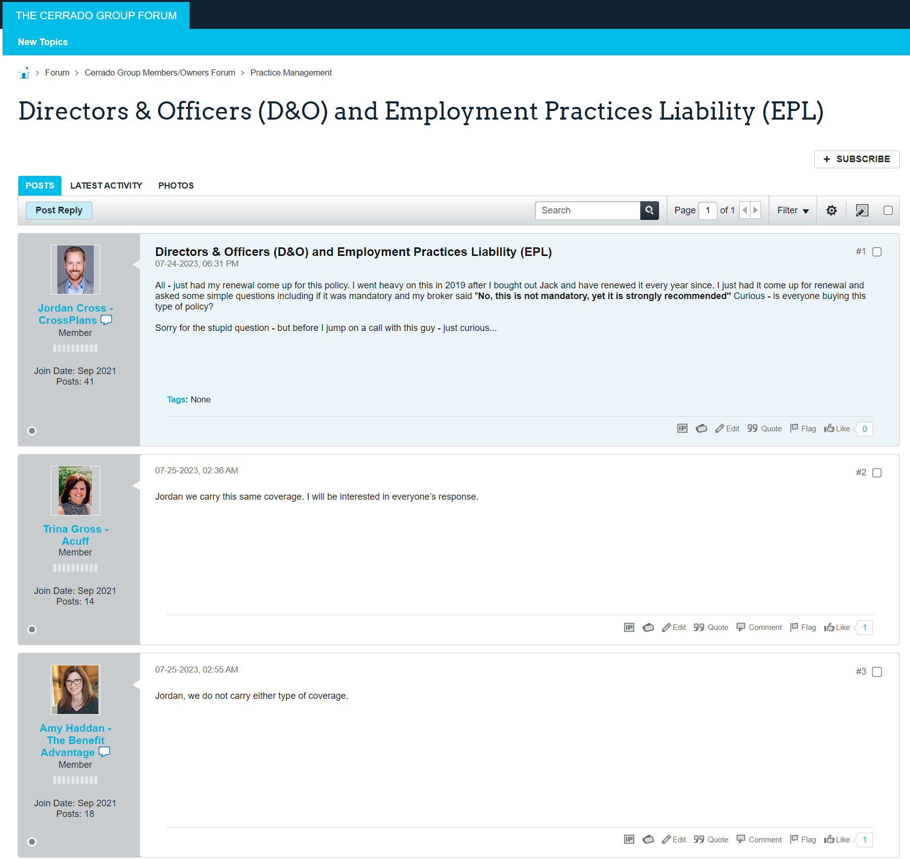
MEMBER OWNERS FORUM – Topic ITEM Page
When you select a Post from the Topic Page (highlighted in Orange below) – you will then be taken to that post and be able to see the original post and the responses – you can also reply by just clicking on the “Post Reply” box – as seen above Jordans head in the image to the right.

Slide 10
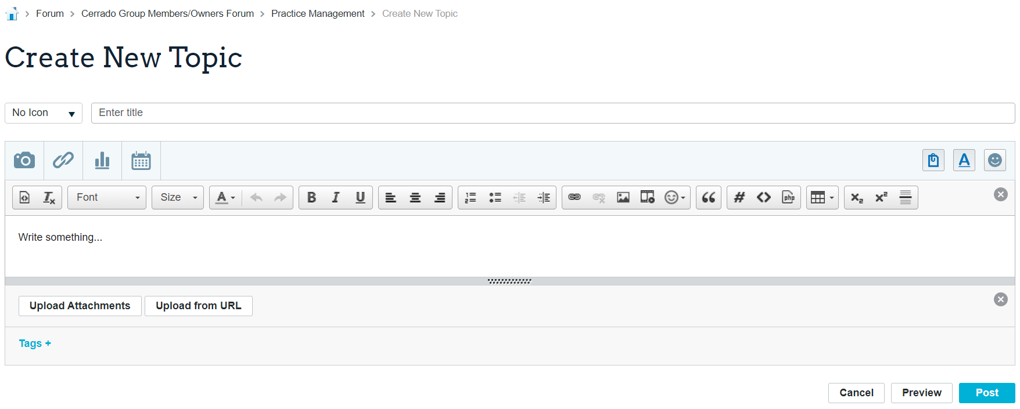
Review the Basics
Adding A NEW TOPIC
To post something – go to a Topic Area and select the NEW TOPIC button.
Then fill in the information on the New Topic screen that opens under Create New Topic.
Once you have filled it in – select POST button (circled in RED) on the bottom of the screen and the Topic will be posted for everyone to see – an email will also go out to members saying that a new topic has been posted.
In Addition – when anyone responds to that post you will be notified of their response via email.

Slide 11
Review the Basics
When a member creates a new post on a topic you have subscribed to, you will receive an email notification
You can simply click on the link in the email and you will be taken to the new post.
See The Appendix for other helpful hints

Slide 12
Demo
https://478cc3fdea6d-005790.vbulletin.net/forum/main-forum

Slide 13
Topics
Compensation- Employee comp
Plan Opportunities- Plans you don’t want but another member may
Recordkeepers- Anything pertaining to a Recordkeeper
Technical Questions- Plan Design and Administration
Practice Management- HR, 3(16), Restatements, Efficiencies
Staffing- Exit Interviews, Recognition, Employee Retention Programs
Useful Information/Shared Info
Other?
Ann’s Emails?

Slide 14
Likes/Dislikes/Improvements
Existing Users
Others
Training/Rollout
Ann will distribute these slides
Will do a better job with new members
Success Factors
Everyone must be set up and ready to go by Sept. 8th
Everyone must use
Everyone must commit to not using email- asking and responding

Slide 15
Appendix

Slide 16
Other Information and Details on Using the Forum
Anyone that posts a TOPIC or creates a REPLY to any post will automatically be subscribed to that topic. That means that you will receive notifications of activity on that post.
You can SUBSCRIBE to anything on the forum by simply selecting the subscribe button that appears on every topic page – so if you are interested in the discussion – but don’t want to participate you can be notified of activity in that area.
You can upload images, URLs and other files to share with the group in any topic area.
Every registered Forum user in all categories has their posting and responding activity tracked by the forum – those numbers appear on every post page and are readily visible to everyone.
On the RIGHT SIDE of the main Forum page, you will also see a list of CHANNELS – which is the list of all of the main topic areas on the entire Forum – this is a quick way to jump to an area of interest.
At the very bottom of the main Forum page is a box that says “What’s Going On” – this will show you who is currently on the Forum besides yourself.
If you click on any Members Name – you will go to their profile page where you can message them privately and see what their last post was as well.
If you go to your own profile page you can also see what you are subscribed to and also your own posting details.
If all else fails - you can reach out to Peter directly at peter@sunraydirect.com.

